Slide 1

Identifikasi Bioprospeksi Senyawa Aktif Tumbuhan Rempah-Rempah di Resort Wonoasri Taman Nasional Meru Betiri
Tri Ratnasari

Slide 2
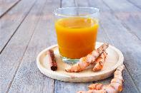

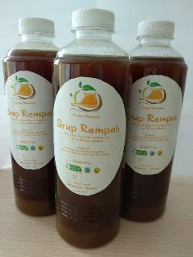
introduction
product safety information is needed, so that it can build consumer confidence
identification of the compound contained
know the benefits and side effects of compounds contained
Such information will build consumer confidence

Slide 3
Material and metod
This research was conducted in Agustus until Nopember 2019 in the Botany Laboratory and Biotechnology Laboratory, Department of Biology, Faculty of Mathematics and Natural Sciences, University of Jember.
Sample preparation
qualitative test of secondary metabolites
Sampling
exstraction
flavonoid
Alkaloid
Fenol
Mg-HCl
Dragendorf
FeCl₃

Slide 4
result

Slide 5
conclution
Bahan baku sirup herbal antara lain adalah gula jawa sebagai pemanis, kapulaga sebagai pewangi, kayu manis sebagai penambah aroma dan sereh, jahe, kunyit, cabe jawa sebagai bahan aktif yang memberi kasiat minuman sirup herbal. Tumbuhan bahan baku sirup herbal yakni Jahe, Cabe Jawa, Sereh dan Kunyit positif mengandung Alkaloid, Flavonoid, Fenol.

